Slide 1
Database Management System (DBMS)
Key Concepts: ER Diagram, Design Issues, Weak Entity
Computer Science & Engineering
Group 2
01 | Mgasa Lucas | 23171055045
02 | Khadija Magono | 23171055023
03 | Kennybright muabuzi | 23171055024
04 | Dorica Kaanda | 23171055046
05 | Happy Mbelwa | 23171055007
06 | Melckzedeck Mbiduka | 23171055029

Slide 2
Overview
In this presentation, we will cover three core concepts in DBMS:
ER Diagram
Design Issues
Weak Entity
A project use case will be used to illustrate all concepts clearly. – HOSPITAL MANAGEMENT SYSTEM

Slide 3
Entity-Relationship (ER) Diagram
An ER Diagram refer to diagram that visually represents data and relationships in a database.
It has the following components:
• Entities (e.g., Student, Course)
• Attributes (e.g., Student_ID, Name, age)
• Relationships (e.g., Enrolls)
Example: A Student enrolls in multiple subjects / Programs ( consider image below).

Slide 4
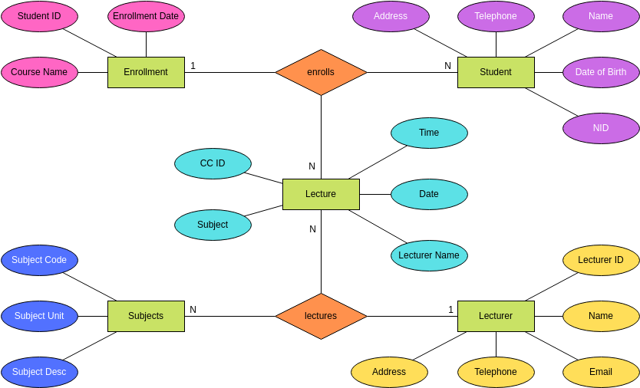

Slide 5
ER Diagram Example
Example: University Database
Entities: Student, Course, Departments
Attributes: Student_ID, Name, Course_ID, Title
Relationship: Enrolls (Student ↔ Course)
This relationship can have attributes such as Enrollment_Date.

Slide 6
Design Issues in Databases
Designing a database involves several key decisions:
• Representation of relationships
• Redundancy elimination
• Data integrity ( being right )
• Entity vs Attribute decision
The goal is an efficient, consistent, and scalable schema.

Slide 7
Design Issue: Redundancy
Redundancy occurs when the same data is stored in multiple places.
Example: Storing a student's advisor name in every course record.
Resolution: Separate entity for Advisor, related to Student.

Slide 8
Design Issue: Relationship Representation
Choosing the right representation for relationships is crucial.
1:1, 1:N, M:N cardinalities must be handled precisely.
Example: One Department has many Professors (1:N)

Slide 9
Design Issue: Attribute vs Entity
Sometimes it's unclear whether to model something as an entity or attribute.
Example: Should Address be an attribute of Student, or a separate Address entity?
Rule: If it has structure or participates in relationships, make it an entity.

Slide 10
Weak Entity
A Weak Entity cannot exist without a strong (owner) entity.
It does not have a sufficient key on its own.
Identified by a partial key and a relationship to its owner entity.

Slide 11
Example of Weak Entity
Example: Dependents of Employees
Entity: Dependent (Name, DOB) → cannot uniquely identify a record.
Owner: Employee (Employee_ID)
Relationship: HasDependent (Employee ↔ Dependent)

Slide 12
Use Case Project: Hospital Management System
We will use a Hospital Management System to illustrate all concepts.
Key Entities: Patient, Doctor, Appointment, Diagnosis
Relationships: Schedules, Performs, Undergoes

Slide 13
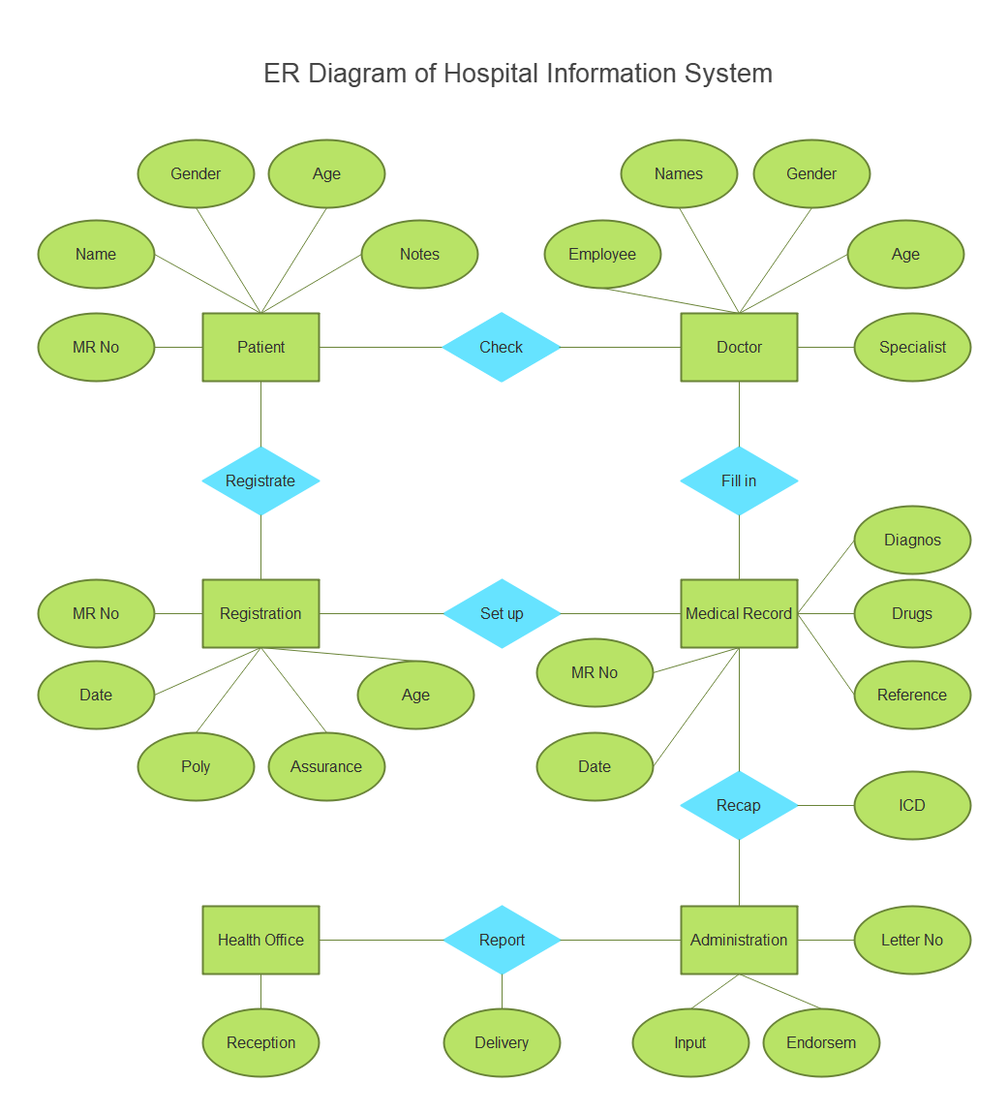
ER Diagram for Hospital Information System

Slide 14
ER Diagram for Hospital System
Entities:
• Patient (ID, Name, Age)
• Doctor (ID, Name, Specialty)
Relationships:
• Appointment (Date, Time)
• Diagnosis (Illness, Prescription)
Example: A Patient schedules an Appointment with a Doctor.

Slide 15
Design Issues in Hospital System
Redundancy: Avoid repeating doctor specialty in every appointment.
Relationship: One doctor, many patients (1:N)
Entity vs Attribute: Make Address a separate entity for reuse.

Slide 16
Weak Entity in Hospital System
Entity: Prescription (Drug, Dosage)
Owner: Diagnosis
A Prescription depends on the Diagnosis it belongs to.
Partial key: (Drug, Dosage), but not unique without Diagnosis.

Slide 17
Conclusion & Summary
• ER Diagrams help visualize database structure
• Design Issues impact efficiency and clarity
• Weak Entities rely on owner entities for identification

Slide 18
Thank You!

